Slide 1
Welcome to the Summer Diocesan Meeting
An Invitation to Come SOAR with Us
Service – What Life is About
Optimism – The Faith that Leads to Achievement
Aspire – to Accomplish Great Deeds
Responsibility – to do Your Duty

Slide 2
Diocesan Meeting
An Invitation to Come SOAR with Us

Slide 3
Faith Program

Slide 4
Agenda
Into the Breach
Holy Hour
Spiritual Reflection
Building the Domestic Church Kiosk
Pilgrim Icon
Refund Support Vocations
Rosary
Sacramental Gifts
Spiritual Reflection
Silver Rose

Slide 5
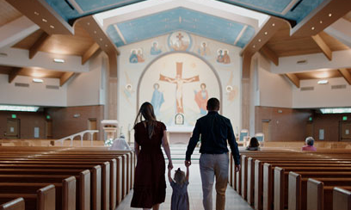
Faith Program
INTO THE BREACH
Form men in spirituality and the Catholic vision of marriage and family life through highly acclaimed series and discussion.

Slide 6
Holy Hour
Organize a regular Holy Hour or host a Eucharistic Procession.
A HIGHER PURPOSE
Encourage deep personal encounters with Christ through Eucharistic adoration in the form of Holy Hours and Eucharistic Processions. As Catholics, we believe in the Real Presence: that Jesus Christ is truly present – body, blood, soul, and divinity – in the Eucharist. As such, we are compelled to grow in our devotion to Jesus in the Eucharist and to share His presence with the world.
Holy Hour
Organize a regular Holy Hour or host a Eucharistic Procession.
A HIGHER PURPOSE
Encourage deep personal encounters with Christ through Eucharistic adoration in the form of Holy Hours and Eucharistic Processions. As Catholics, we believe in the Real Presence: that Jesus Christ is truly present – body, blood, soul, and divinity – in the Eucharist. As such, we are compelled to grow in our devotion to Jesus in the Eucharist and to share His presence with the world.

Slide 7
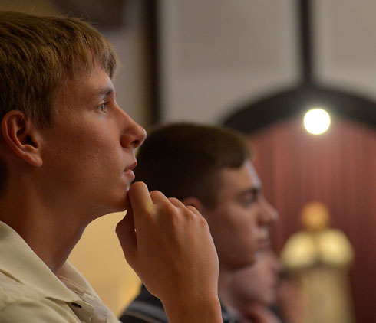
Spiritual Reflection
Create annual opportunities for prayer and reflection together as a fraternity. Under the guidance of their chaplain, councils can attend a retreat or day of reflection together or perhaps organize their own event for the men of their parish.

Slide 8
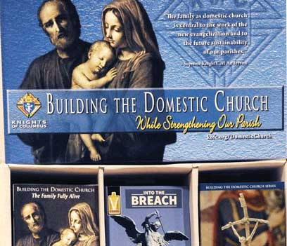
Selecting visual aids
Enhancing your presentation

Slide 9
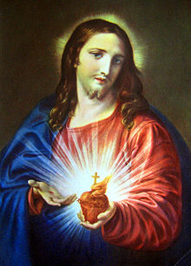
Pilgrim Icon, Sacred Heart of Jesus to be delivered to each SDRR in January 2025 and runs through Fraternal year 2026-2027
This Photo by Unknown Author is licensed under CC BY-SA

Slide 10
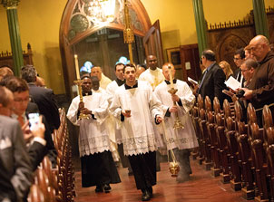
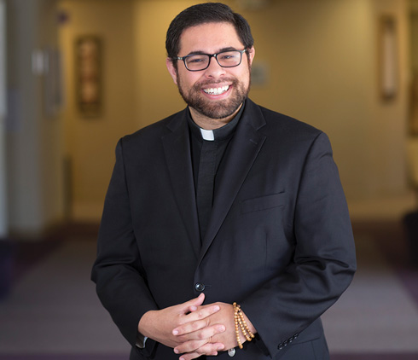
Refund Support Vocations
A HIGHER PURPOSE
Keep the faith alive by supporting our seminarians and men and women religious postulants and novices. As the strong right arm of the church, Knights of Columbus are committed to providing moral, financial and spiritual support to our future priests and religious at all stages of their formation. A featured program, RSVP counts for two credits toward the Columbian Award.

Slide 11
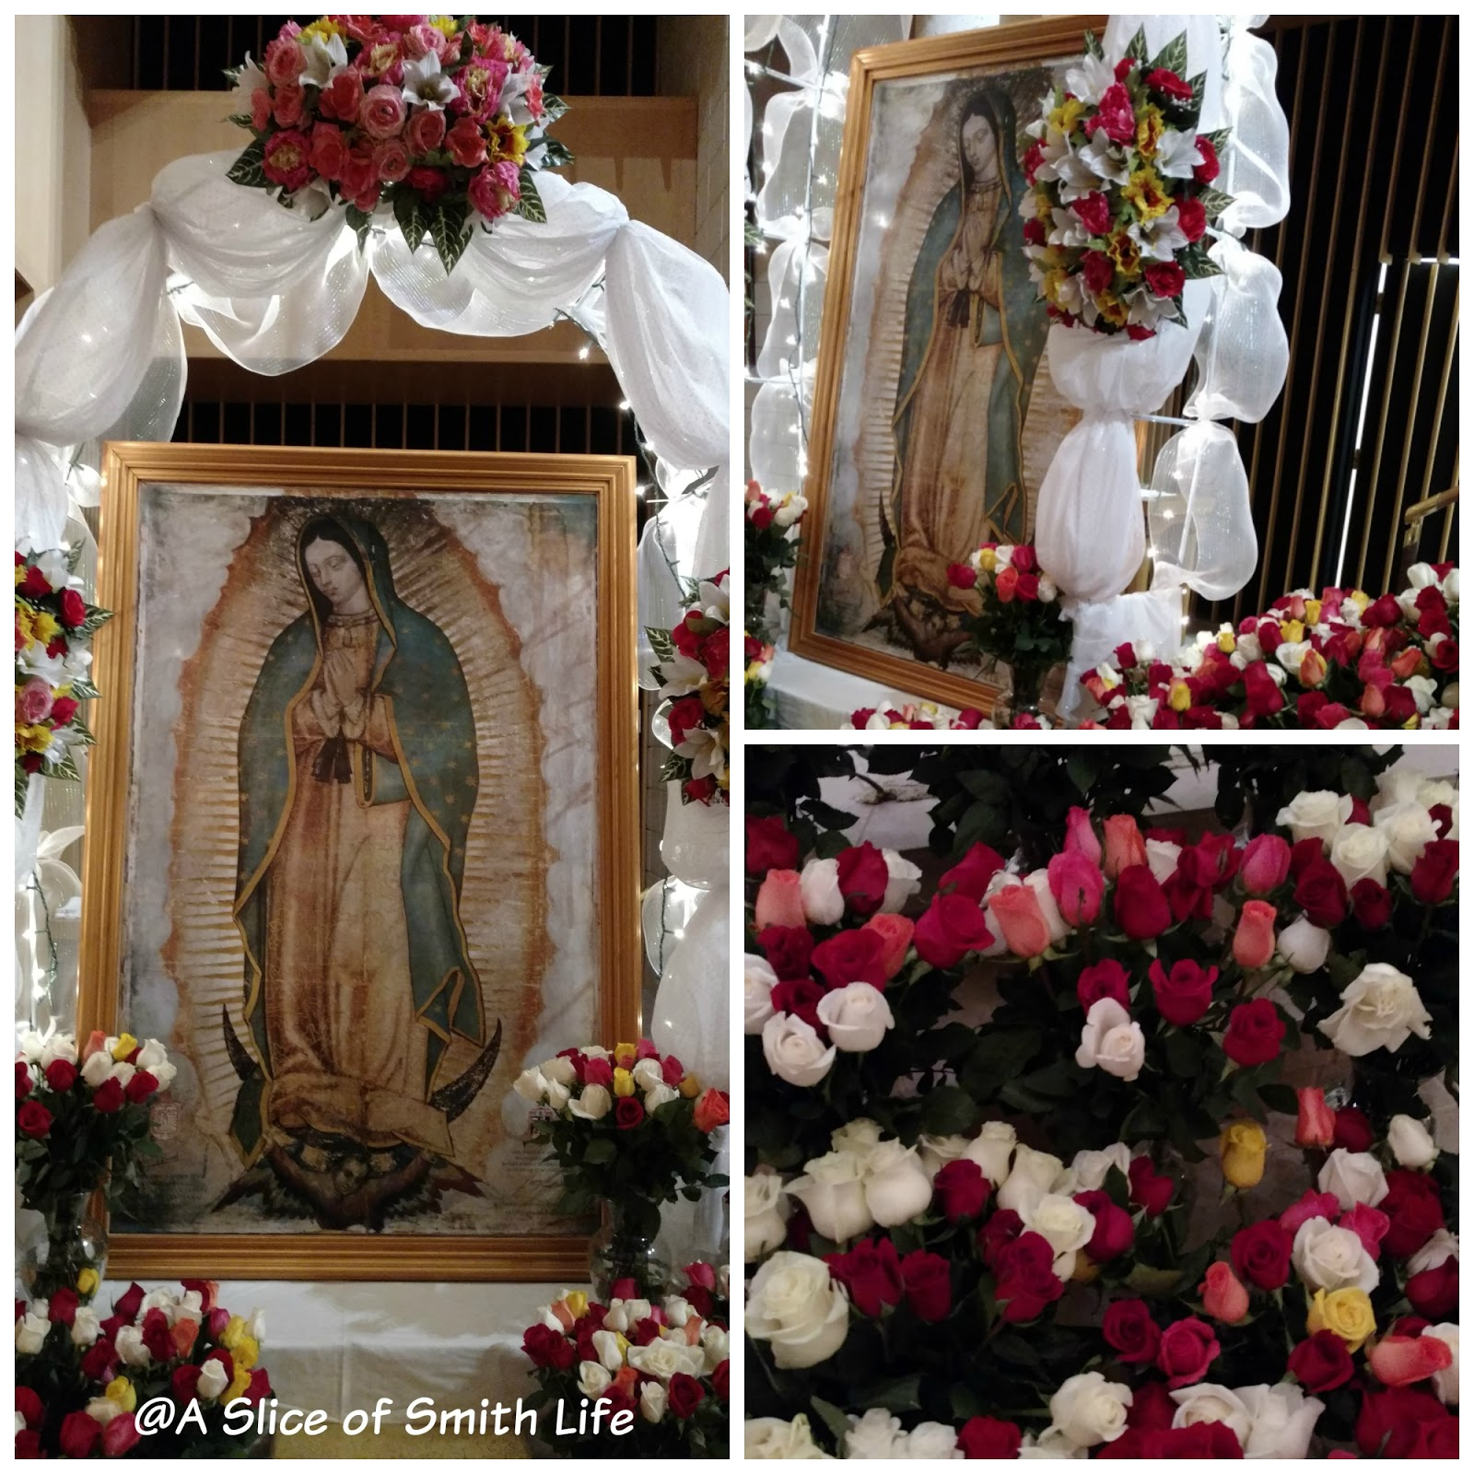
The Silver Rose will be making its way through our State again in 2025. When I know the date it will be transferred to Michigan, I will start setting the dates of availability
This Photo by Unknown Author is licensed under CC BY-NC-ND

Slide 12
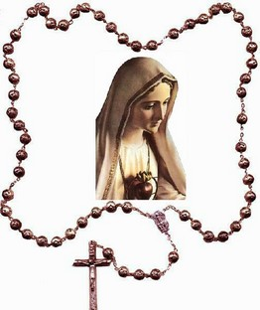
The Living Rosary
The Living Rosary will be held on the Lansing Capital Lawn on September 13, 2025.
The importance of this date is that our Holy Mother had her apparition on the 13th of the month

Slide 13
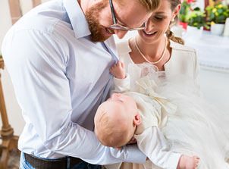
Sacramental Gifts
Consistent rehearsal
Strengthen your familiarity
Refine delivery style
Pacing, tone, and emphasis
Timing and transitions
Aim for seamless, professional delivery
Practice audience
Enlist colleagues to listen & provide feedback
Support families during the most important events in the life of the domestic church: the sacraments. Councils will play an integral role in these momentous faith events and the lives of our families and parish community through prayer and the presentation of symbolic gifts.

Slide 14
Michigan Knights of Columbus Email Jeff Thomas State Email Director
Notes:
1

Slide 15
MI KofC Email
Council
GKXXXX Grand Knights
FSXXXX Financial Secretaries
MDXXXX Membership Directors
PDXXXX Program Directors
Notes:
1 GKXXXX Grand Knights
2 FSXXXX Financial Secretaries
3 MDXXXX Membership Directors
4 PDXXXX Program Directors
5 Share until July 1st – Then... Hand it Off!!!
4

Slide 16
Email access & Email Support
Notes:
How to Logon
Go to WWW.mikofc.org
On Home Page – Right Boxes scroll down to:
1 Box called Systems click on Google mail
5

Slide 17
STATE RAFFLE
KEVIN ROWLEY & MICHAEL HAUGHEY

Slide 18
Over 60k tickets were sold for the 2024-2025 State Raffle
Detroit – 31,031 sold
Gaylord – 3,616 sold
Grand Rapids – 5,866 sold
Kalamazoo – 2,832 sold
Lansing – 10,742 sold
Marquette – 1,758 sold
Saginaw – 5,055 sold

Slide 19
District Deputies were sent updates with council sales
District 125
Council Council Earnings Members Potential Earnings
3042 $467 273 $3,276
3191 $36 66 $792
5460 $280 337 $4,044

Slide 20
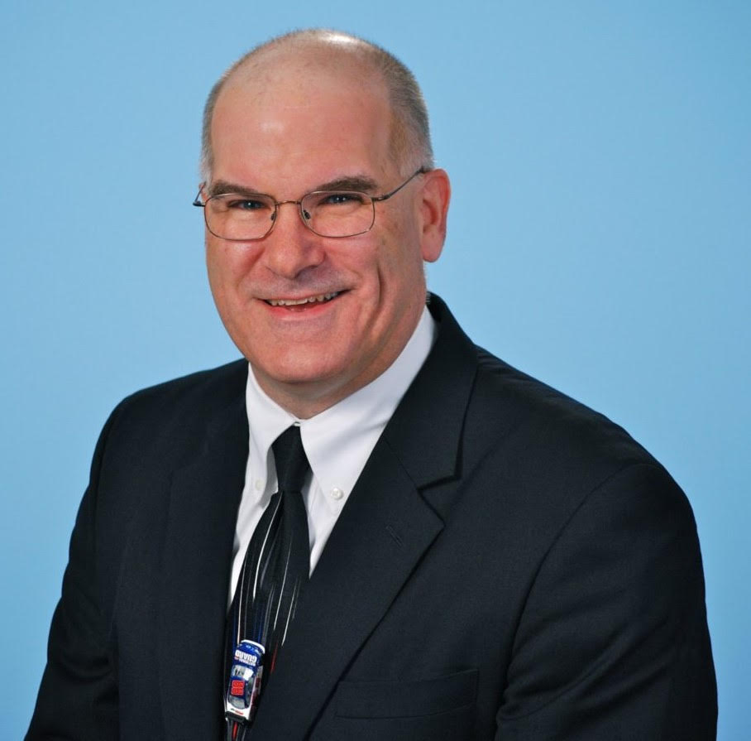
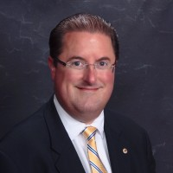
Have you been trained for this year
Joe Langhauser
Dean Hayworth
State Training Director
Council Training Director
Notes:
Trainer Customization Instructions
Please customize this slide with your name and role before presenting.
This Train-the-Trainer session will be led by:
Joe Langhauser, State Training Director
Dean Hayworth, Training Director North
I expect that State Deputy Diocesan Directors will make any necessary customizations to tailor the presentation as required.
Thank you for your commitment to this training process!

Slide 21
Live Training Season is Winding Down
Training for Grand Knights, Program and Membership, Financial Secretaries w/ Trustees and Treasurer Training
Thank you to those that attended live sessions and to all the trainers that helped out
We know that councils that are well trained achieve Star Council at a significantly higher rate
Training materials are available on the state website
(You do need xxx@mikofc.org email to access)

Slide 22
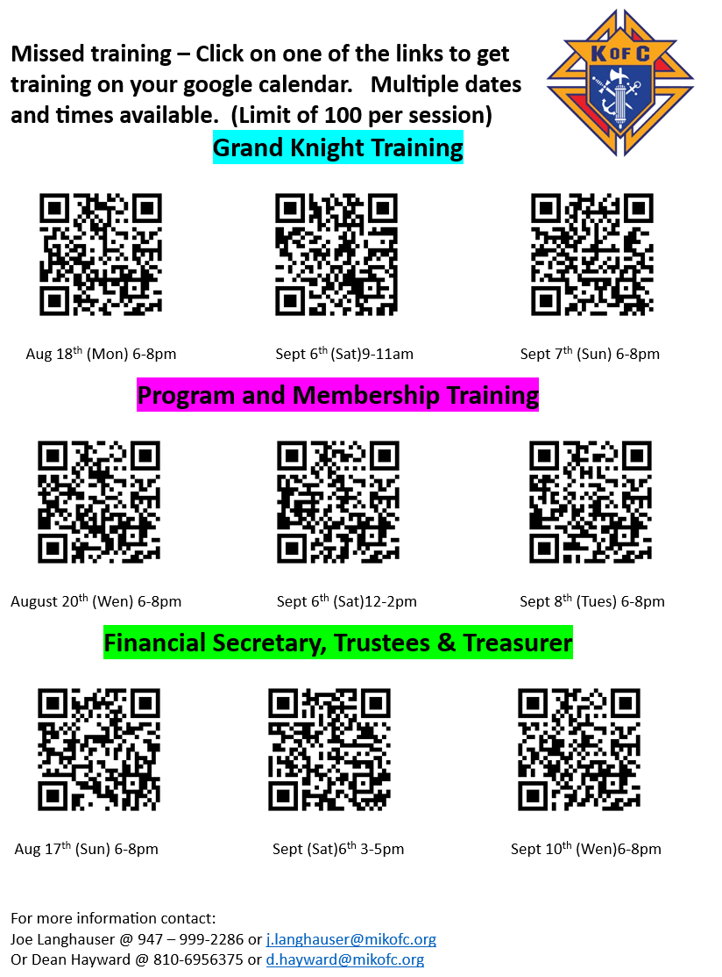
Catchup Training Links
Have missed training?
We have “catchup” training
Use one of the QR codes to have the training put on your calendar directly
These are all online sessions

Slide 23
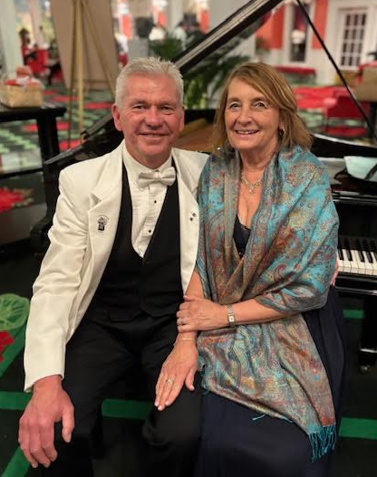
Take Courage In All You Do!
Ed and Lynn Strach Pro-Life Chair Couple
SOARing For Life!

Slide 24
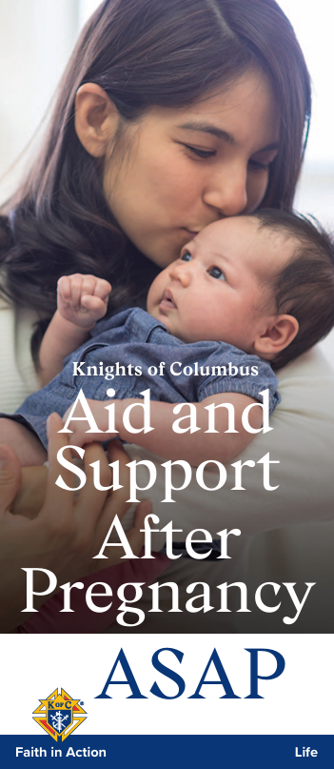
Building Courage – ASAP100
2025 – 2026 Fraternal Year Goals
Achieve 100% council participation from all active councils.
Agreed by District Deputies at the Summer Leadership meeting.
All monetary and other donations accepted!

Slide 25
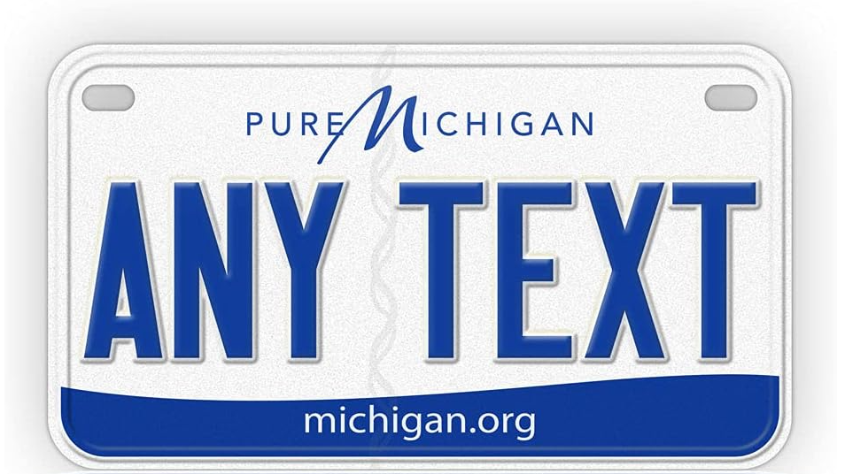
ASAP100

Slide 26
Beyond 100 Ultrasound Units
Sacred Heart Mercy Healthcare, Alma; Servants of the Holy Family Council #2966
Positive Options, Holland; St. John Neumann Council #7115
Spero Pregnancy Center, Port Huron; Bishop William F. Murphy Council #3257
Positive Options Pregnancy Center, Allegan; St. Catherine of Siena Council #6980
Lennon Center, Dearborn Heights; Fr. Patrick O’Kelly Council #3860
Women’s Care Center, Niles; St. Mary of the Lake Council #14366
Pregnancy Helpline, Sturgis; Deacon Jerry Mix Council #2508

Slide 27
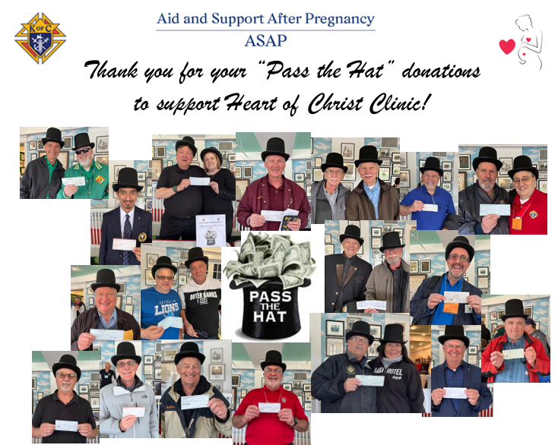
Donations totaling $64,711!
$52,911 raised by councils, assemblies and personal donations!
$12,500 matched by the Supreme Council!

Slide 28
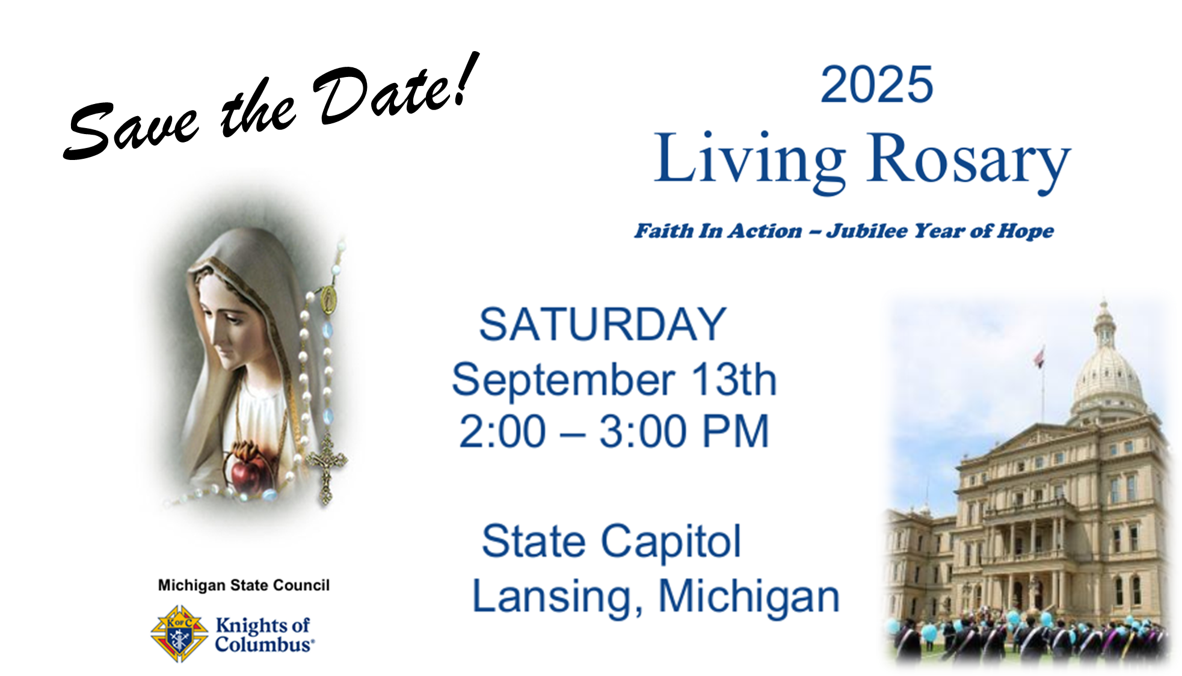
Thursday, November 6, 2025, at the State Capitol

Slide 29
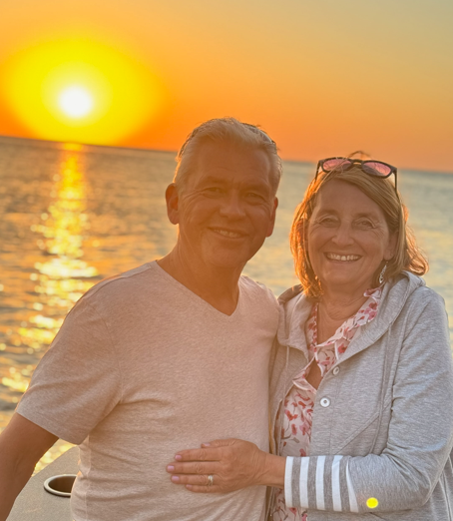
Take Courage In All you Do!
Ed and Lynn Strach
Contact us at e.strach@mikofc.org or 734-476-6296

